Slide 1
POLICY MANAGEMENT SYSTEM
GROUP CODE: 4
INTERNAL GUIDE : Mr. Dhwanir Shah
EXTERNAL GUIDE: Mr. Prashant Malvaiya
GROUP MEMBERS :
Contractor Mohammed H (3016)
Saiyed Rumaila R (3074)
Shah Zeel B (3060)

Slide 2
POLICY MANAGEMENT SYSTEM
Policy Management System includes a Web Portal for the Agent/Admin so that he/she can manage his/her client .
It also includes an Android application that will help the client/user to get information without calling the agent .

Slide 3

COMPANY PROFILE
COMPANY NAME: EXPERT WEB-DESIGNING
ADDRESS : 1st Floor , 124 Platinum Plaza , Opp. Kunj Mall , Nikol-Naroda Road,Ahmedabad,382 350.
CONTACT NUMBER : (+91) 8000436640.
CONTACT PERSON : Prashant Malvaiya.
EMAIL ID : info@expertwebdesigning.com
WEBSITE : www.expertwebdesigning.com

Slide 4
EXPERT WEB-DESIGNING is an Indian IT Company for Software Development ,Website Development, Web Hosting, Web Designing, Search Engine Optimization, Mobile Solutions and lot many IT and IT Enabled Services.
EXPERT WEB-DESIGNING is a Software Product based company who develops different software products and sell into Market. EXPERT WEB-DESIGNING is in Website Solutions and Mobile Solutions with SEO Services. EXPERT WEB-DESIGNING is only Product based company who creates products for their customer IT company and promote them.

Slide 5
Requirement Gathering
To create a Web-portal for the agent from where he can manage all the details of his/her clients.
To create an Android application for the clients , so that they can see all the policies they have purchased , their premium amounts , payment dates , new policies , maturity dates etc.

Slide 6
What Agent Expects ?
Agent can login to the system and access the login panel.
Agent can add the company and Policy details to present it to his/her clients.
Agent can manage the client details who are purchasing policy from him/her.

Slide 7
Agent can manage the data of client and policy purchased by them.
Agent can view and send reminder for policy premium to his or her client.
Send notification about new policy to all customers.
Agent can generate the various types of reports like pending premium amount report , Date wise policy opening reports etc.
Agent Can Generate Quotation for any policy/policies for the client by providing criteria like Budget / Installments etc.

Slide 8
What Client Expects ?
Client can login to the system and access its functionality.
Client can view his or her profile.
Client can view all the policy details which taken by him or her.
Client can view all the details about premium of policy which is paid by them.

Slide 9
Client can view the new policies for purchasing
Get reminder for unpaid premium and upcoming premium.
Get notification for new policy sent by the admin.
Client Can add policies he/she is interested in, to his/her wish list.

Slide 10
EXISTING SYSTEM
What are Agent’s Current role?
The Agent needs to visit the client personally and get various information from the client like Budget , Installments , which type of policy etc and show the client policies accordingly.
Once the client is interested in any of the policy / policies , the Agent needs to prepare a manual quotation for the client for his/her better understanding.
After the client is ready to purchase a policy , the agent need to make the client fill the policy form and get important documents like PAN Card / Passport / Election Card / Driving licence or any other Government generated documents.

Slide 11
Then the client needs to make the payment via cheque to the agent .
After the policy is purchased the main work of the agent starts , he needs to maintain a book / diary having all the details of his/her clients.
Important information like monthly/yearly reports , Unpaid premium , policy maturity etc needs to be created manually and is to be sent via post / courier service.
The agent needs to keep the client abreast about the premium in advance and if needed, has to go to the client’s house to collect the premium.
Every time a new policy is introduced the agent needs to meet the client to make him/her aware about the policy.

Slide 12
What are Client’s current role ?
The client needs to maintain a book / diary to be abreast about the policies that he/she purchased.
Every time the client needs any details about the policy like paid / unpaid premiums , maturity date , new policies , old policies etc.The Client needs to call the Agent to get all the details.

Slide 13
THE DRAWBACKS OF THE EXISTING SYSTEM
Tedious work : It is a tedious work to maintain all the records in a book / diary and keep searching pages for getting information .
Vulnerable : It is not secured as any person who has access to the book / diary has access to all the information .
Cannot Manage Large amount of clients: It is not possible to manage a large number of clients using this system as it is nearly impossible to remember each and every clients details.

Slide 14
Expensive & not eco-friendly : It is expensive as it needs extra staff to maintain large amount of clients.
Not Reliable : Books / Diaries are not reliable as if it is lost then it is impossible to get all the data back.
Consumes more time : The agent needs to visit to the client / call the client for small things like Premiums / reports etc.
Ineffective : It is not effective as the agent needs to manually create quotations , reports .

Slide 15
NEW SYSTEM
The Features Agent will get :
The Agent can send the brochure to the client via Email whenever the client requests for it.
Once the client is interested in any of the policy / policies , the Agent can generate one click Quotation for the client for his/her better understanding and can also send it via Email / post.
After the client is ready to purchase a policy , the agent needs to make the client fill the policy form and get important documents like PAN Card / Passport / Election Card / Driving licence or any other Government generated documents and store the scanned documents in the database , so he can use it whenever needed .For Example : If the client needs to buy new policy no need to take the documents again.

Slide 16
Then the client needs to make the payment via cheque to the agent .
The Agent can enter the client details in the Web Portal and use it whenever needed.
Important information like monthly/yearly reports , Unpaid premium , policy maturity etc can be generated by one click and is sent via Email / SMS / Notification.
The agent can now keep the client abreast about the premium in advance by sending him Email / SMS , and if needed can go to the client’s house to collect the premium.

Slide 17
Every time a new policy is introduced , The agent can send Email / Notification / SMS to the client to make him/her aware about the new policy.
The Features Client will get :
The client can download the application in his/her phone and manage all his details and can view all his details by just signing into the application.
Every time the client needs any details about the policy like paid / unpaid premiums , maturity date , new policies , old policies etc. He/she can login into the application and can check them.

Slide 18
THE ADVANTAGES OF THE NEW SYSTEM
Time Variant : It saves a lot of time as it can generate Quotations/Reports in no time .
Secured : It is secured as only the authorized person can access the data.
Can Manage Large amount of clients: It is possible to manage a large number of clients using this system as each and every clients details are stored unlike the previous system.

Slide 19
Inexpensive & eco-friendly : It is Inexpensive as it no loner needs extra staff to maintain large amount of clients .
Reliable : If in case the data is lost from the system , it can be recovered .
Consumes less time : The agent no longer needs to visit to the client / call the client for small things like Premiums / reports etc.

Slide 20
PLATFORM
FRONT END:JSP & Servlet
Android (Android Studio 2.1).
BACK END: MySQL (5.7.13)
PRESENTATION TOOL : MS POWER POINT 2007
DOCUMENTATION TOOL : MS WORD 2007
DIAGRAM TOOL : MS VISIO 2007

Slide 22
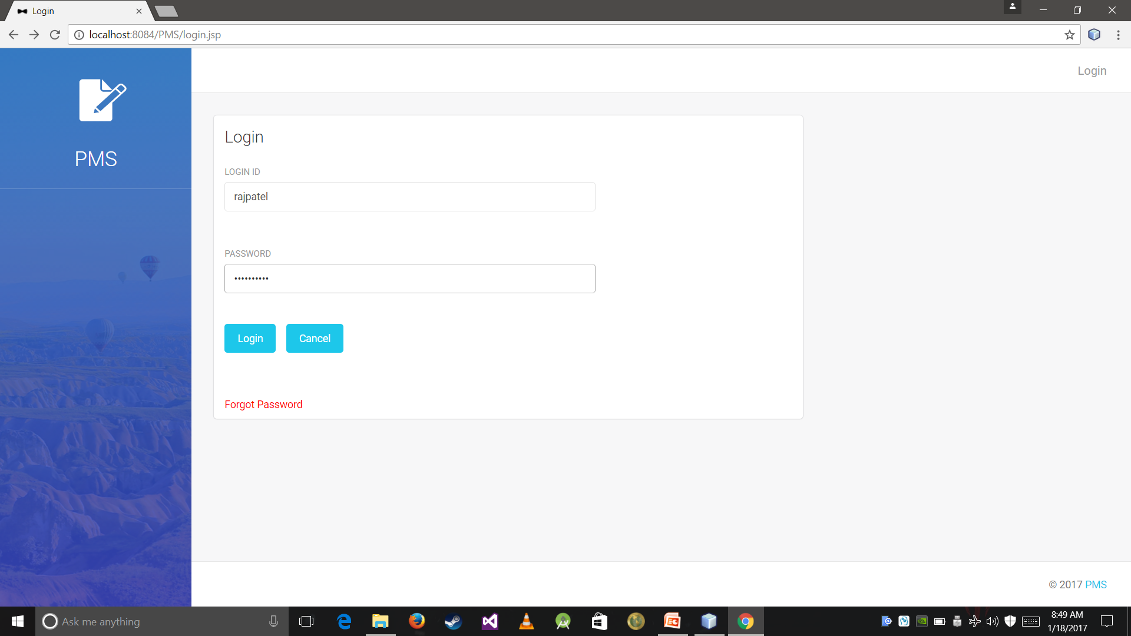

Slide 23
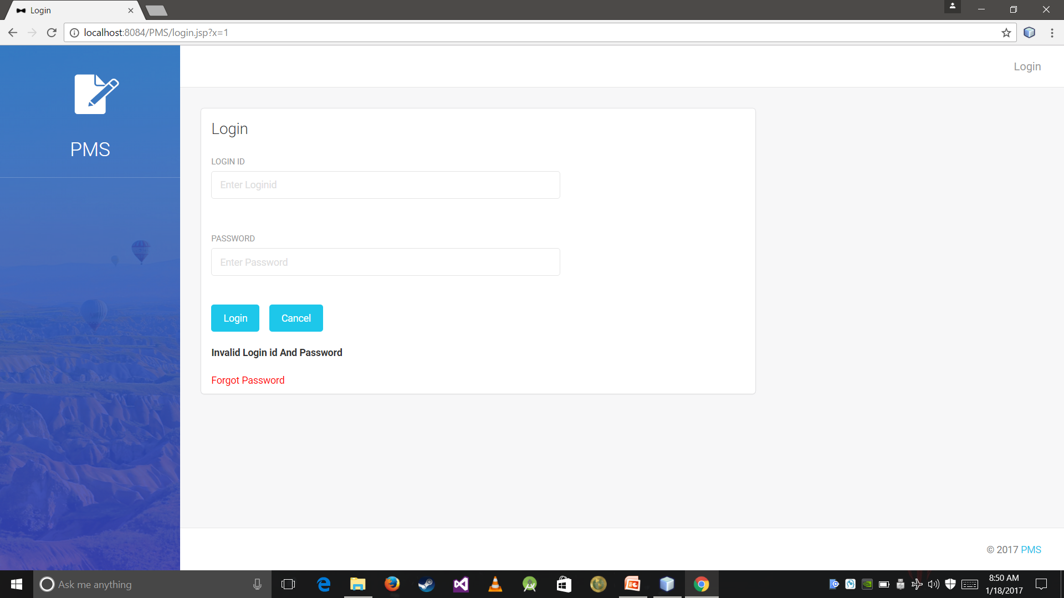

Slide 24


Slide 25


Slide 26
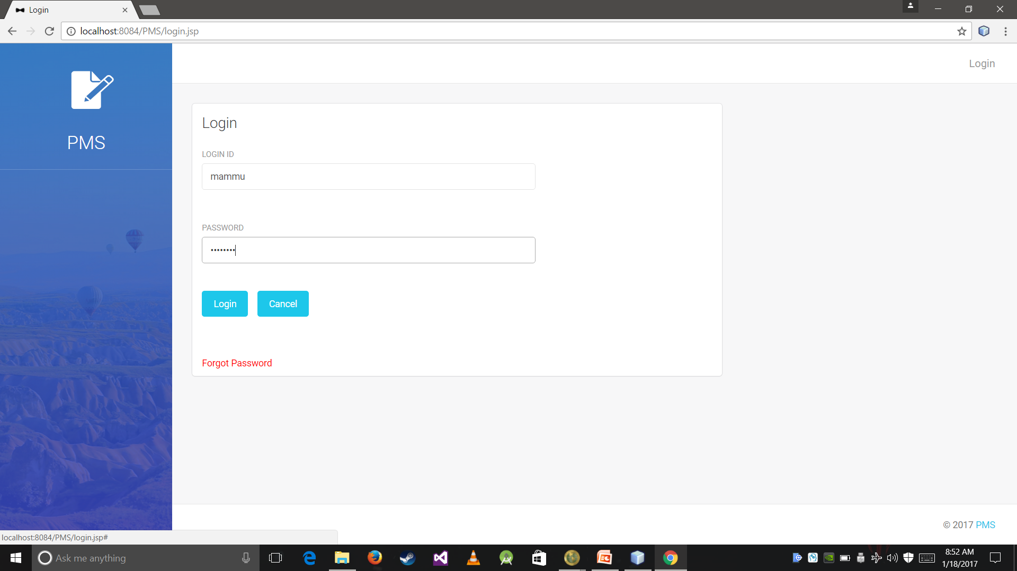

Slide 27
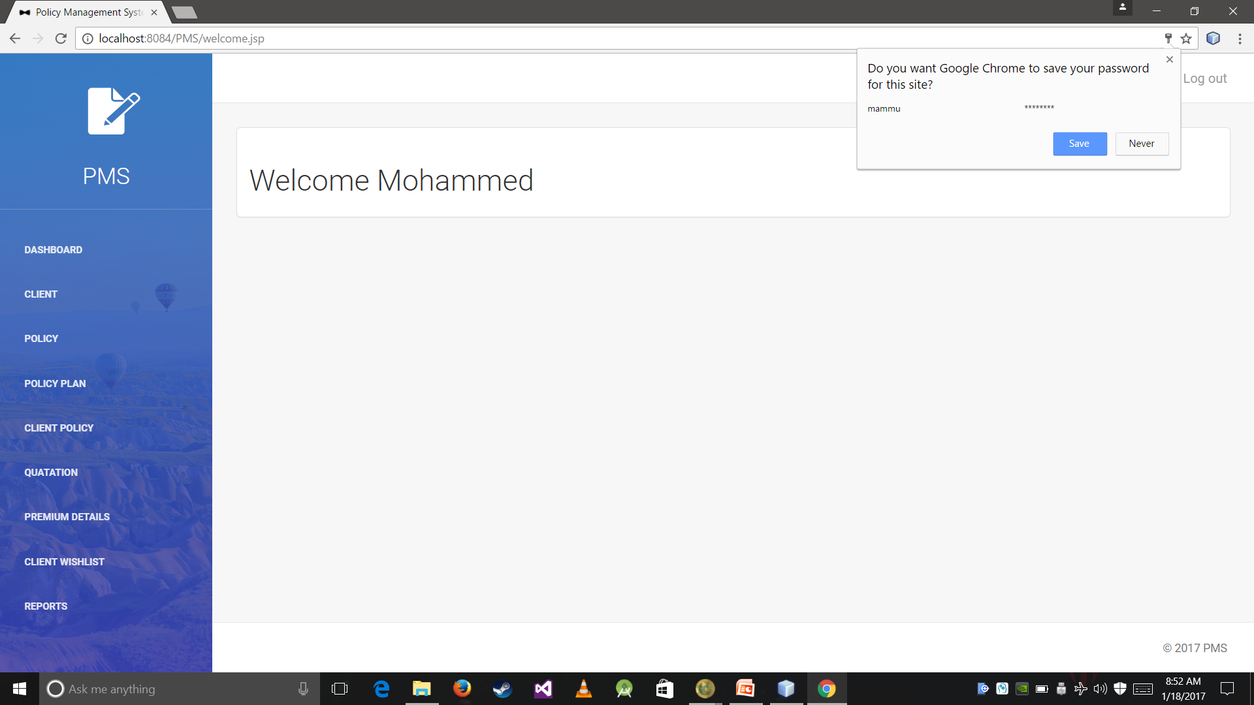

Slide 28
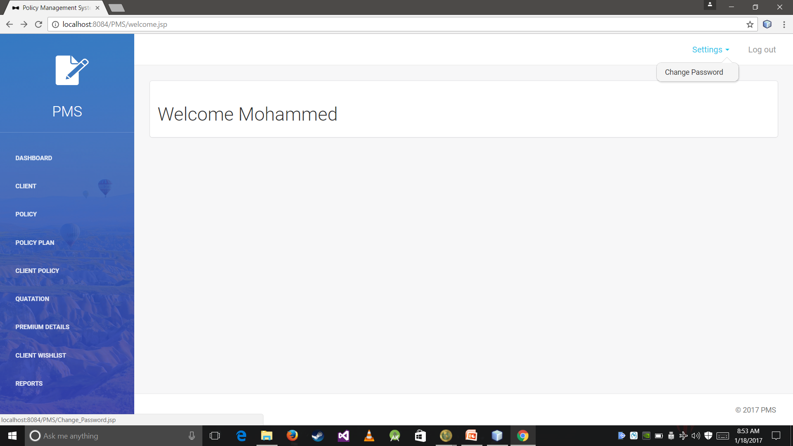

Slide 29
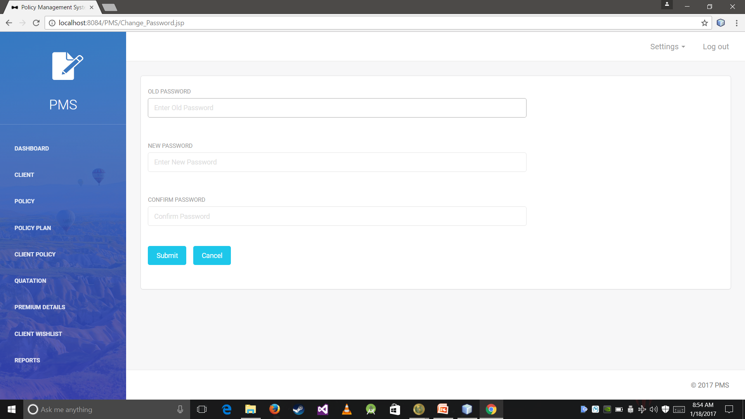

Slide 30


Slide 31


Slide 32


Slide 33


Slide 34
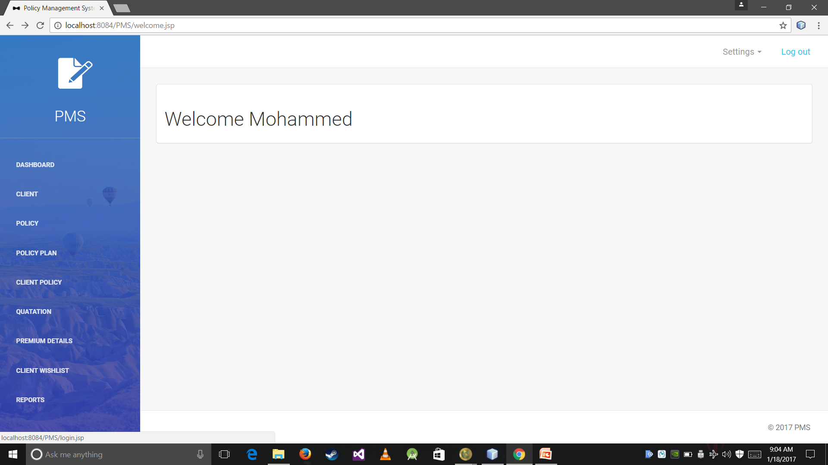

Slide 35


Slide 36
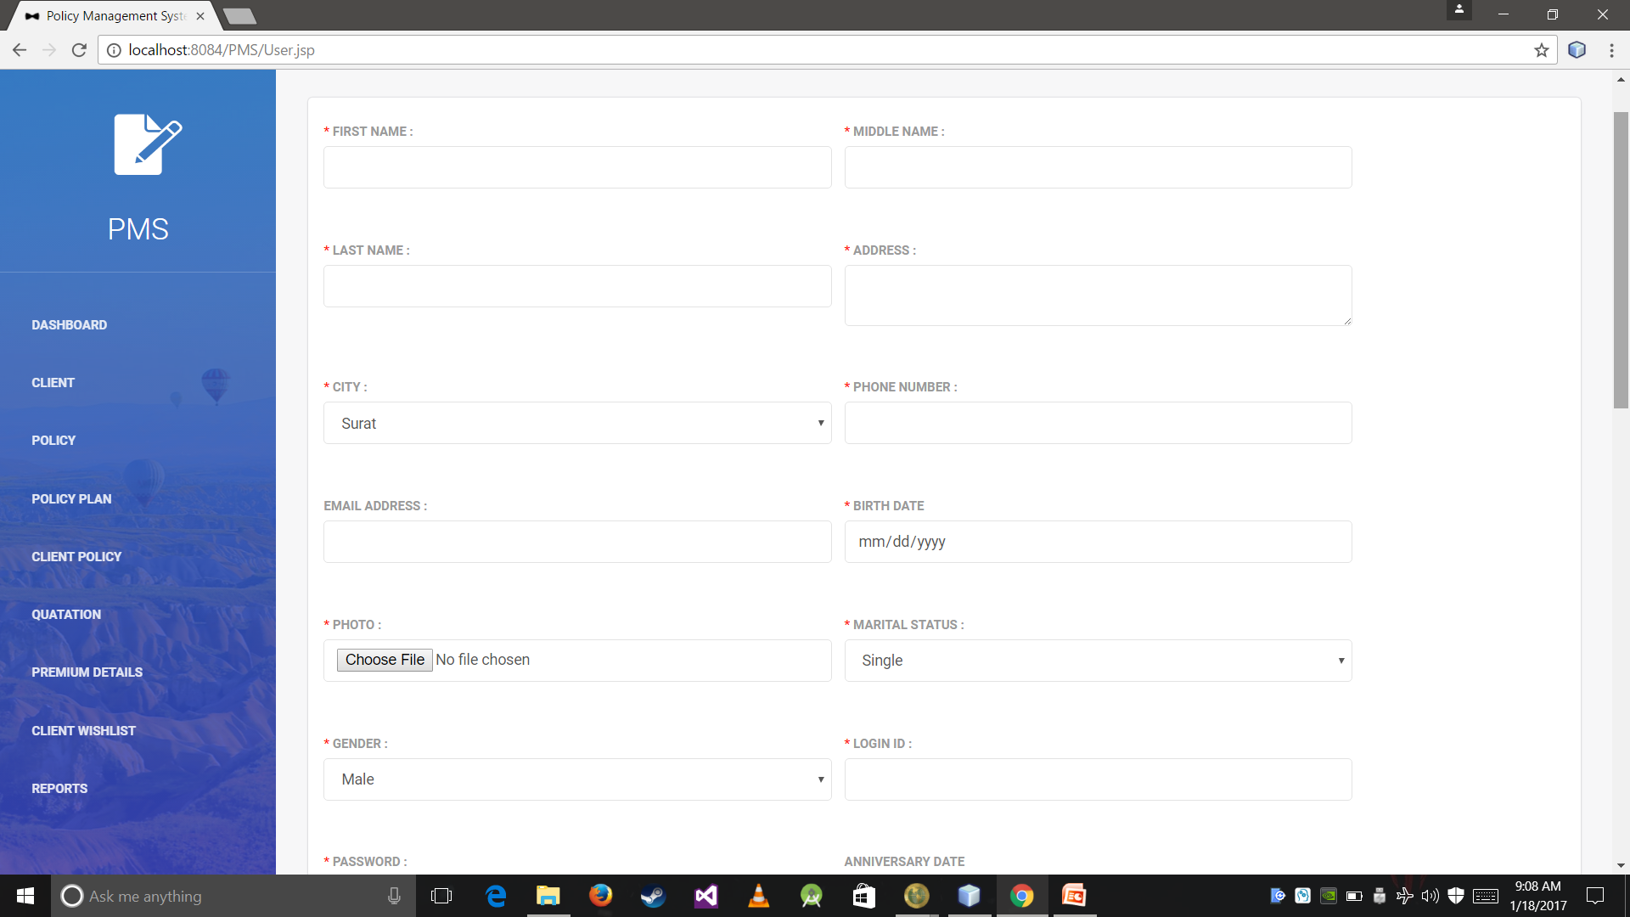

Slide 37
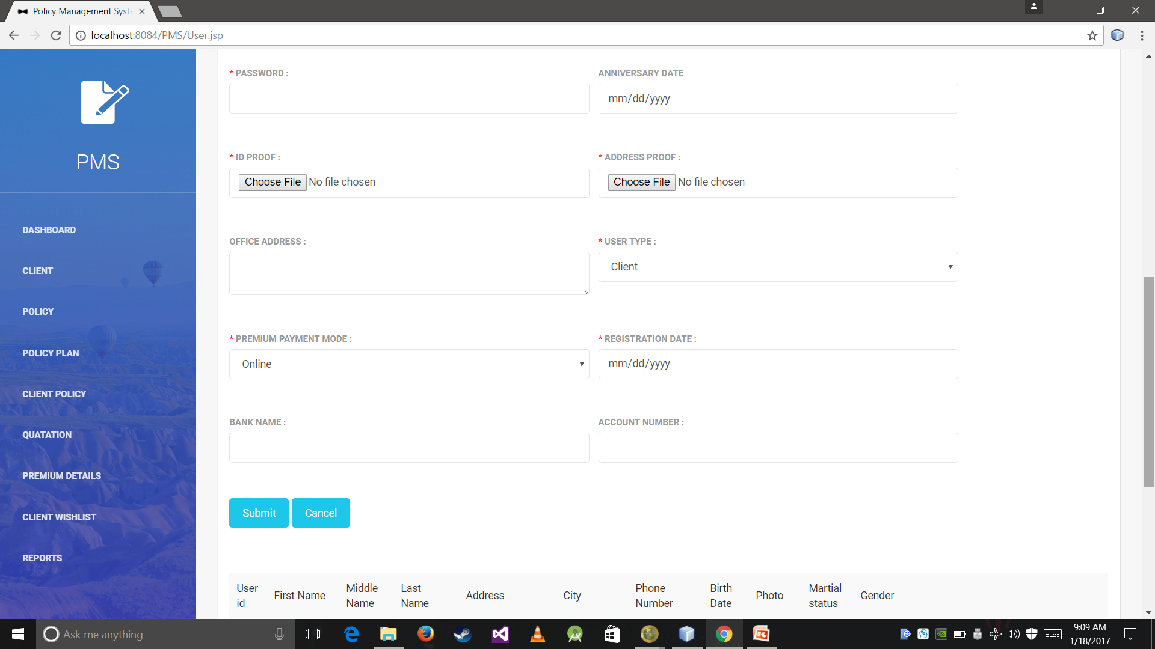

Slide 38
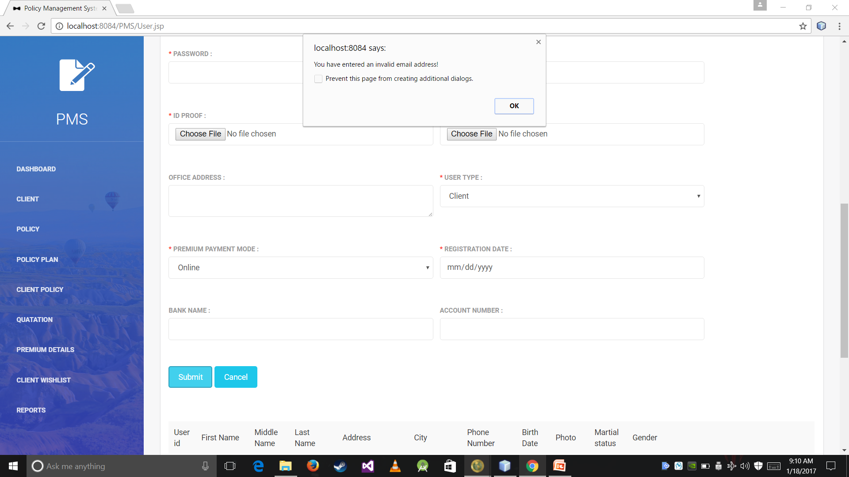

Slide 39
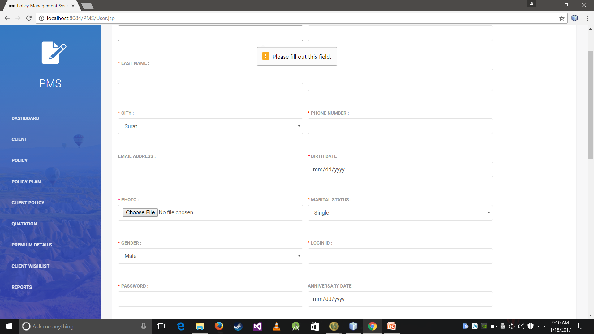

Slide 40
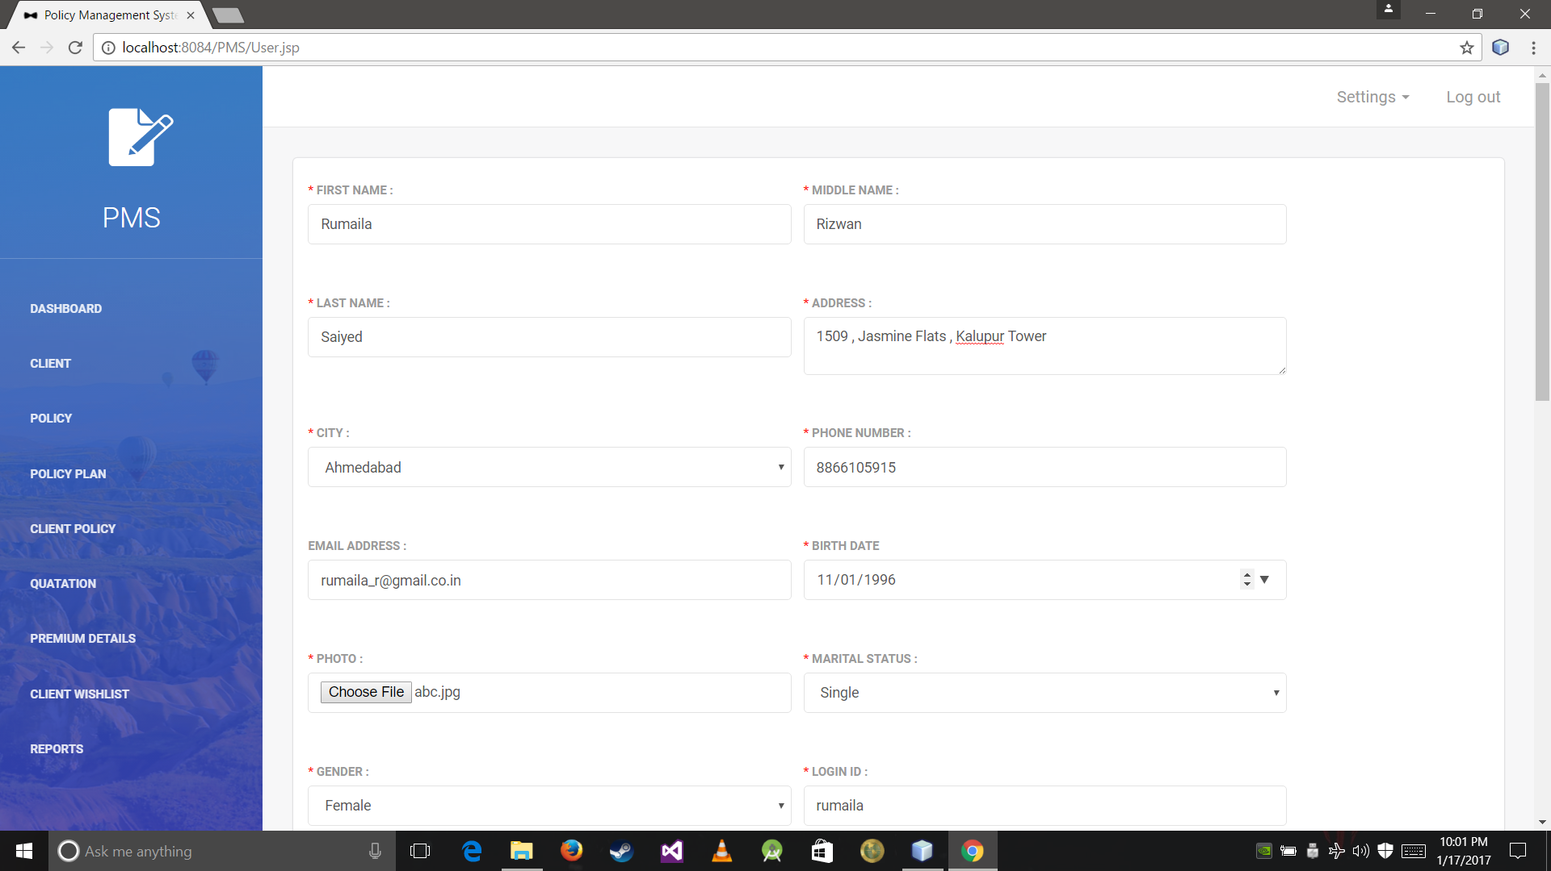

Slide 41
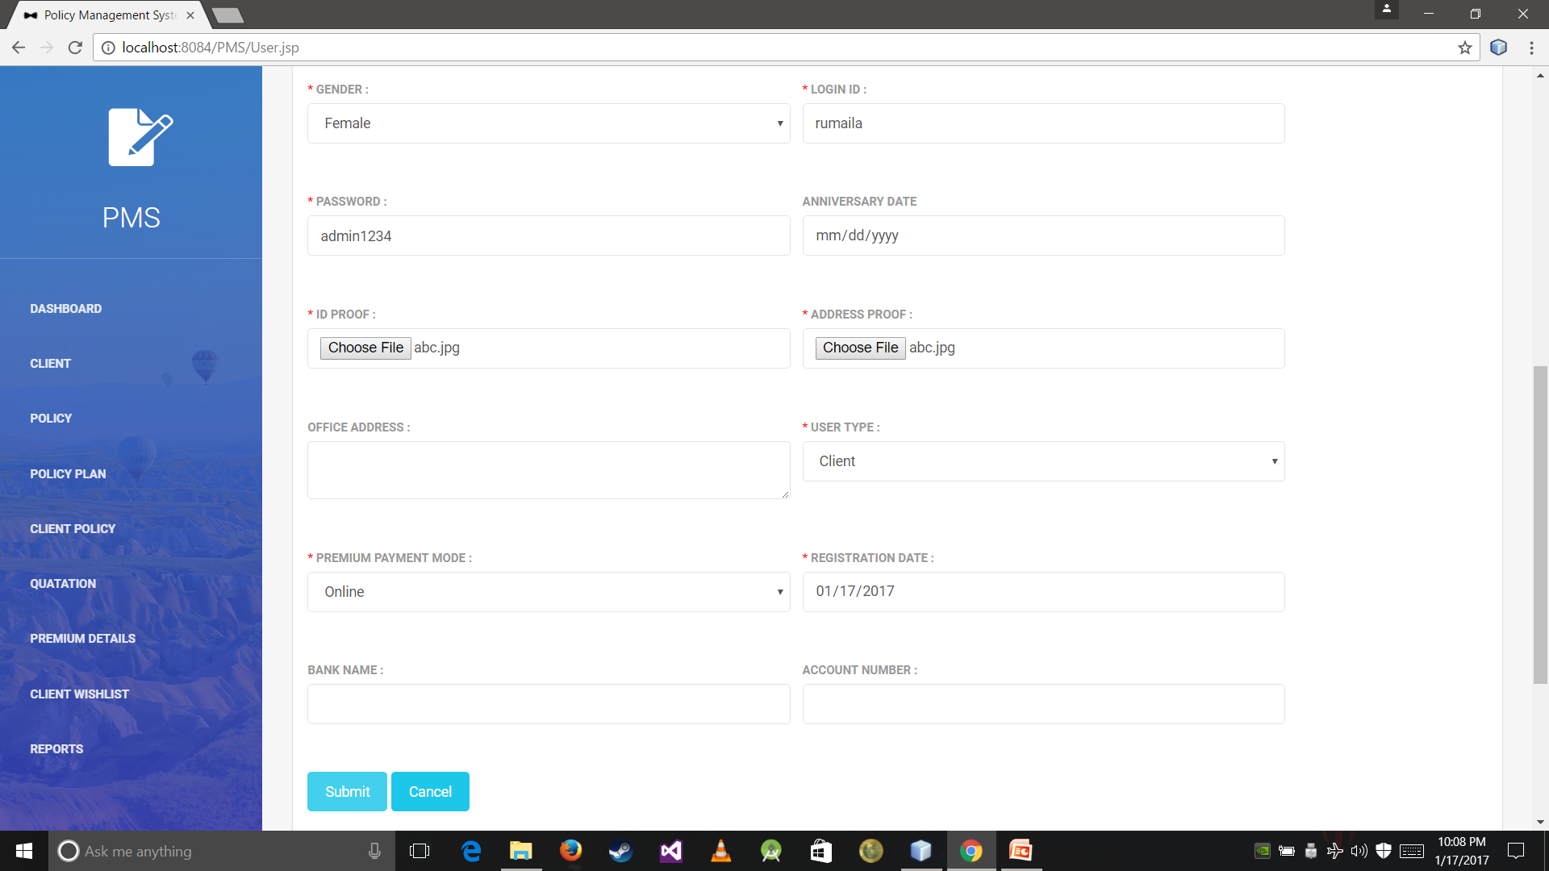

Slide 42
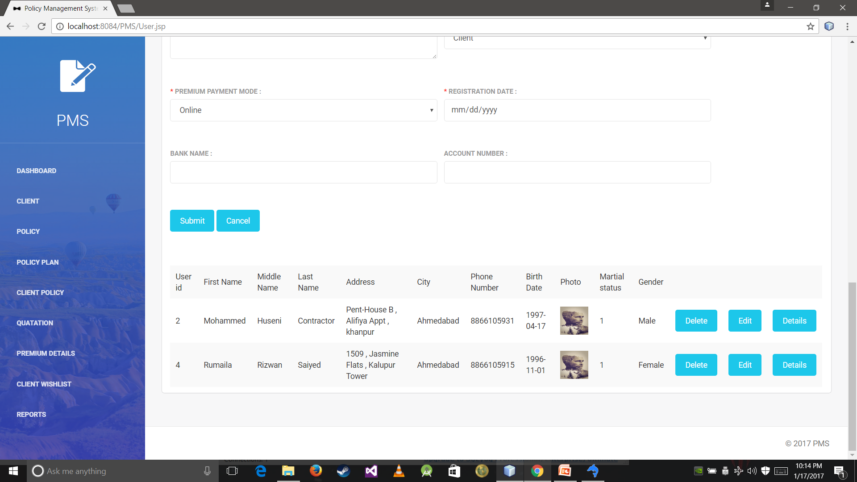

Slide 43
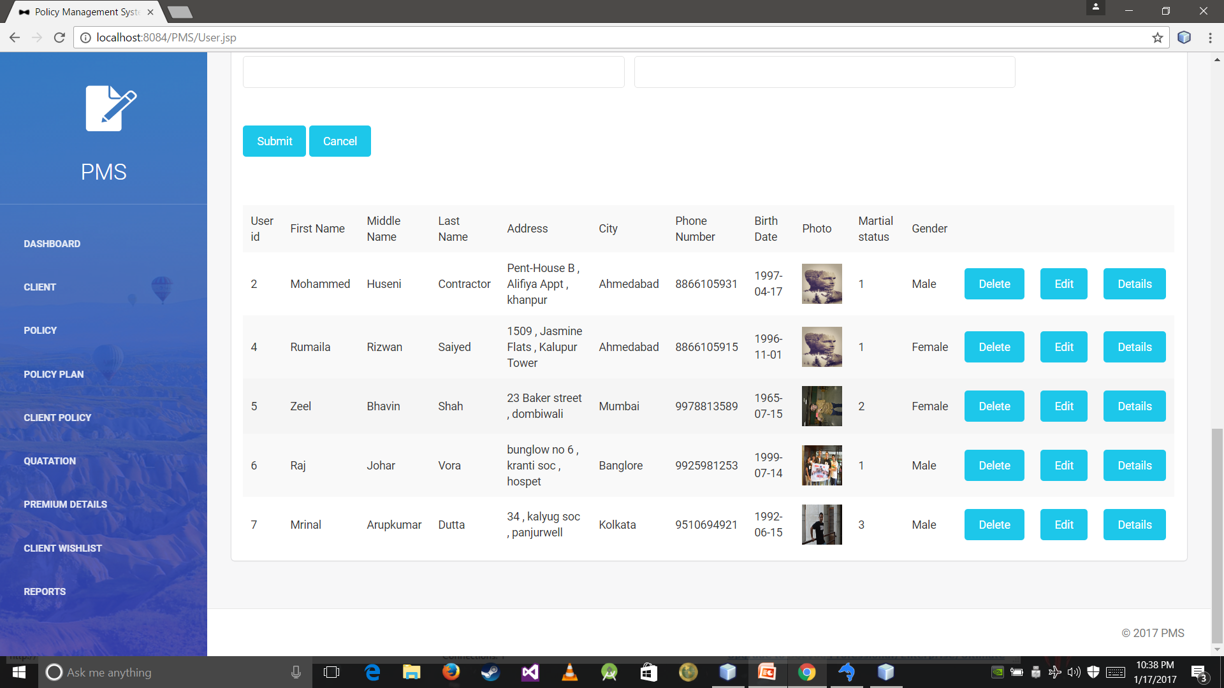

Slide 44
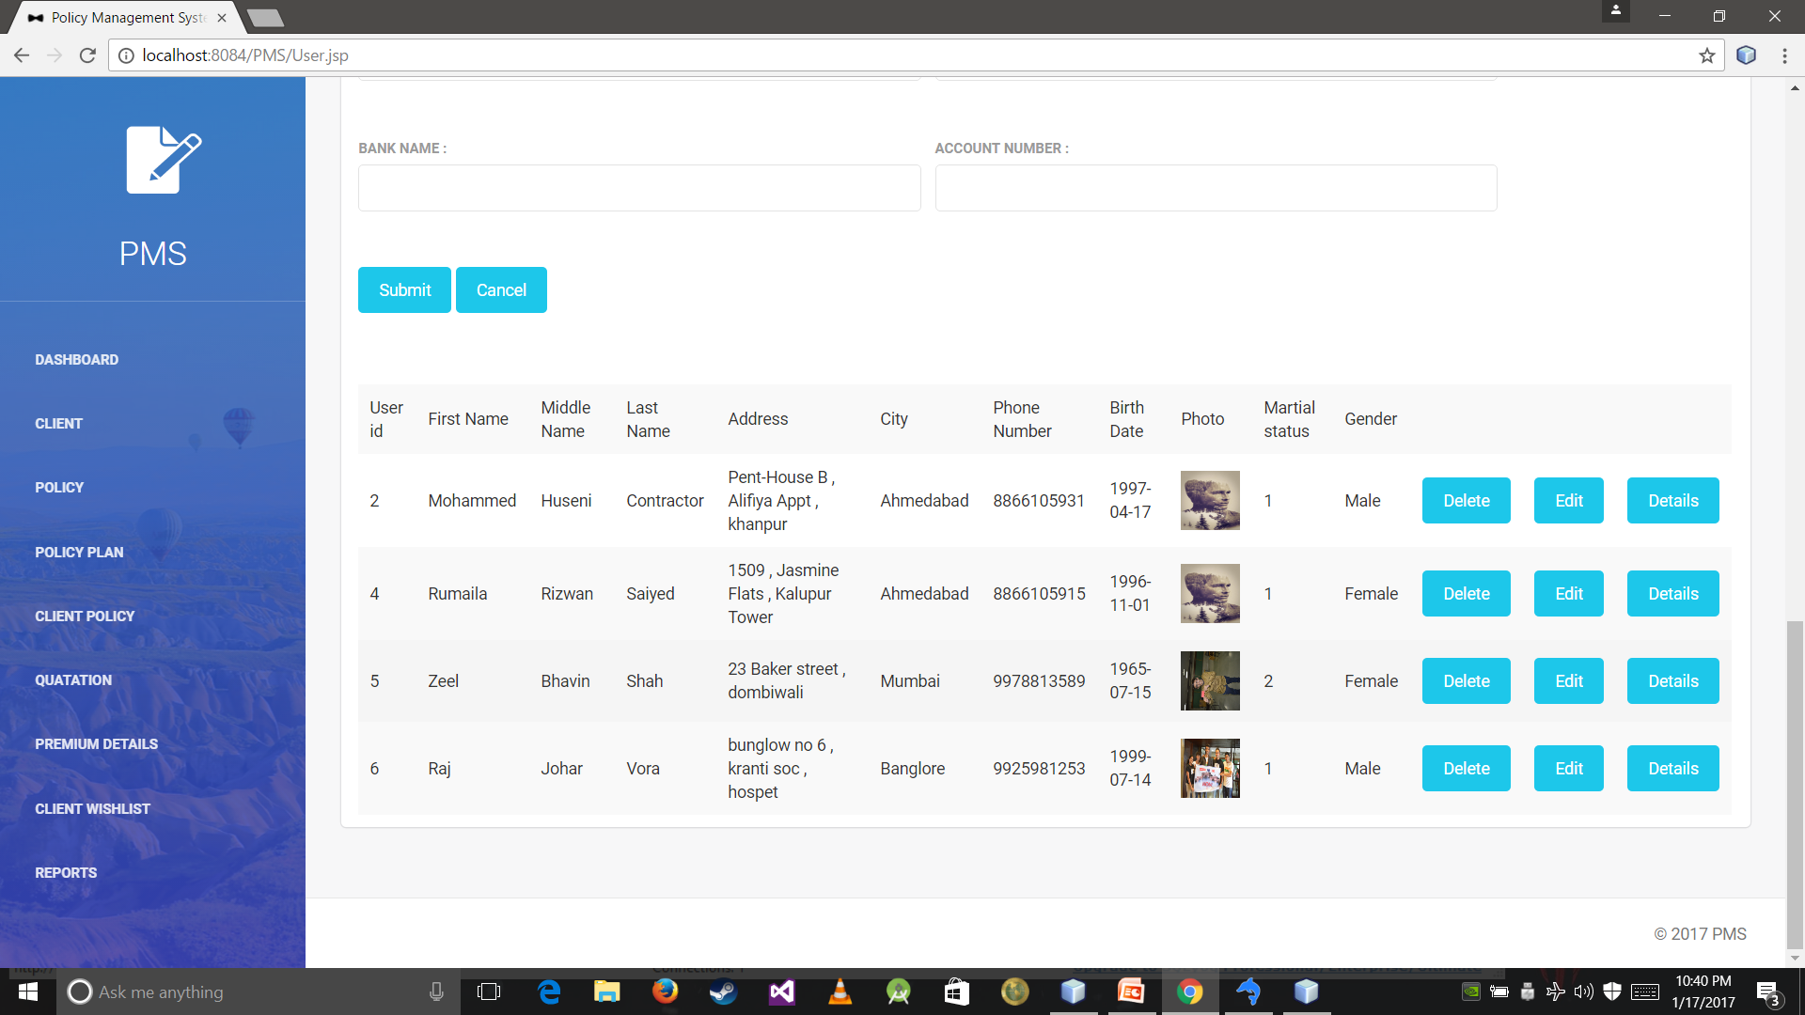

Slide 45
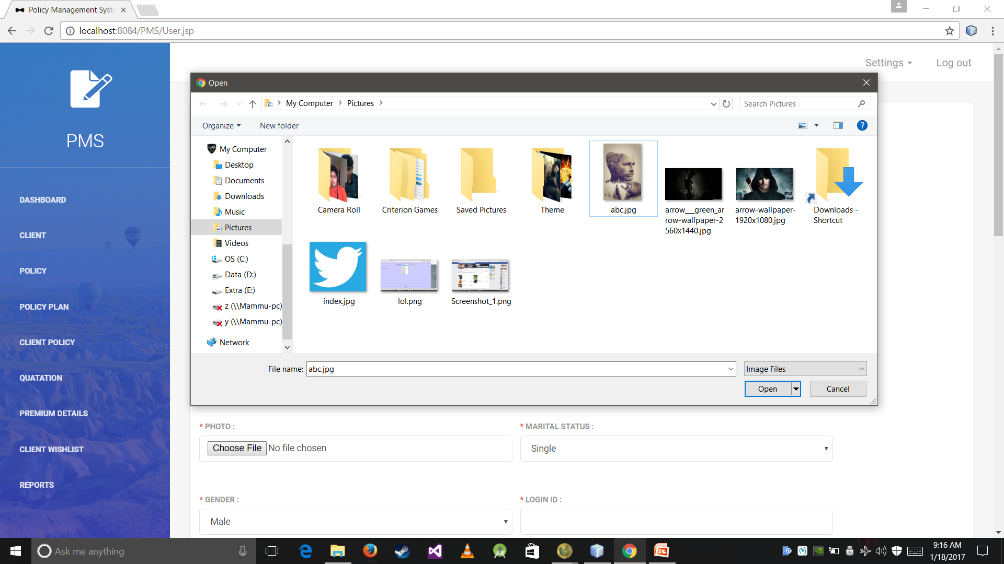

Slide 46
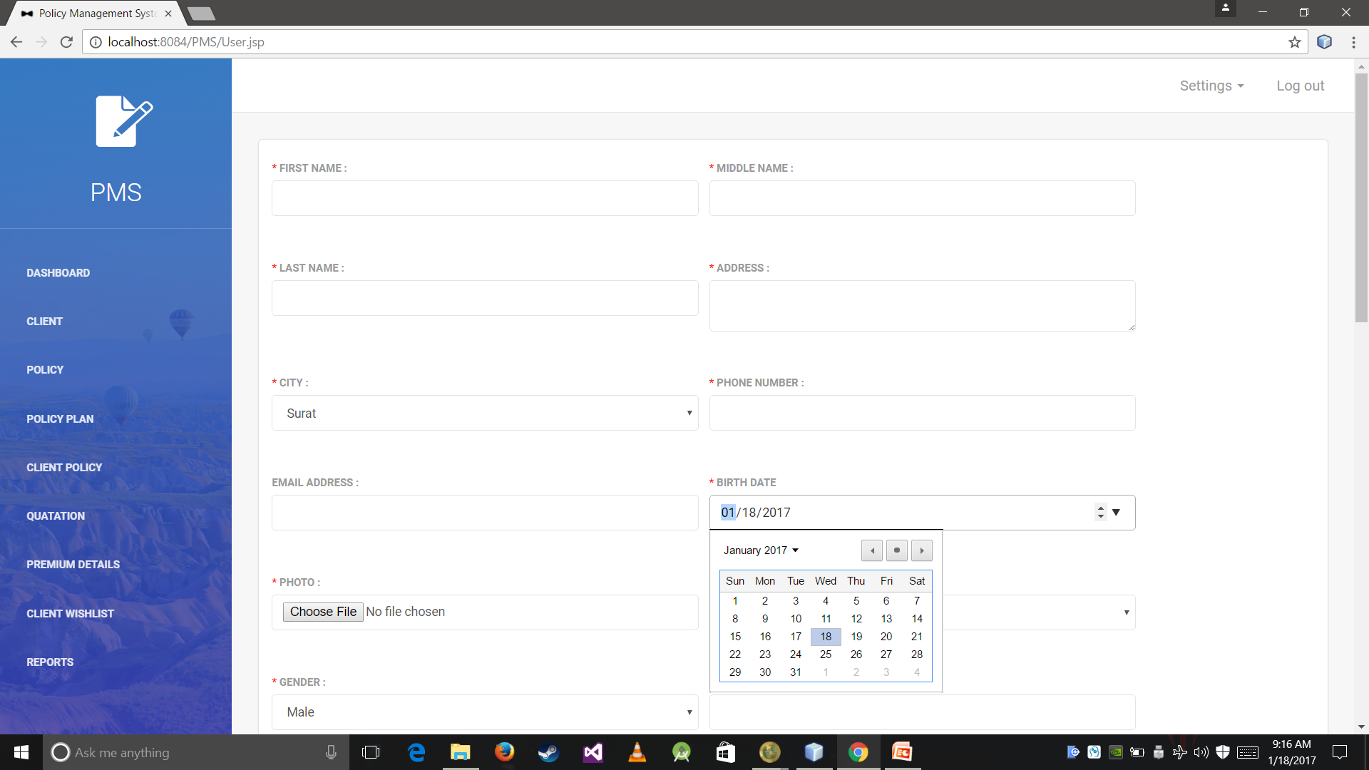

Slide 47
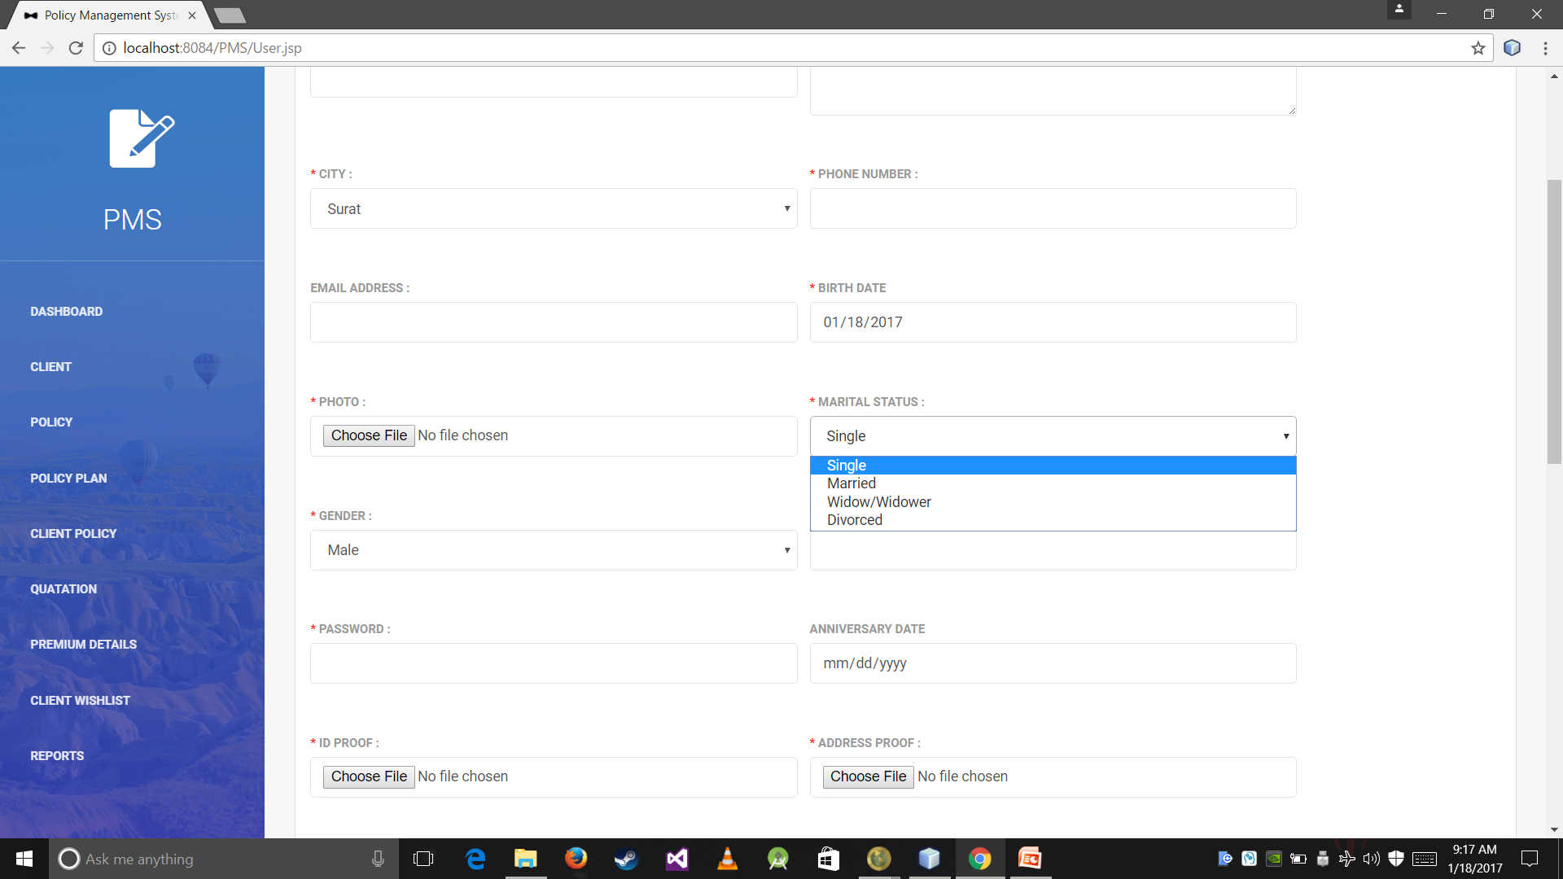

Slide 48
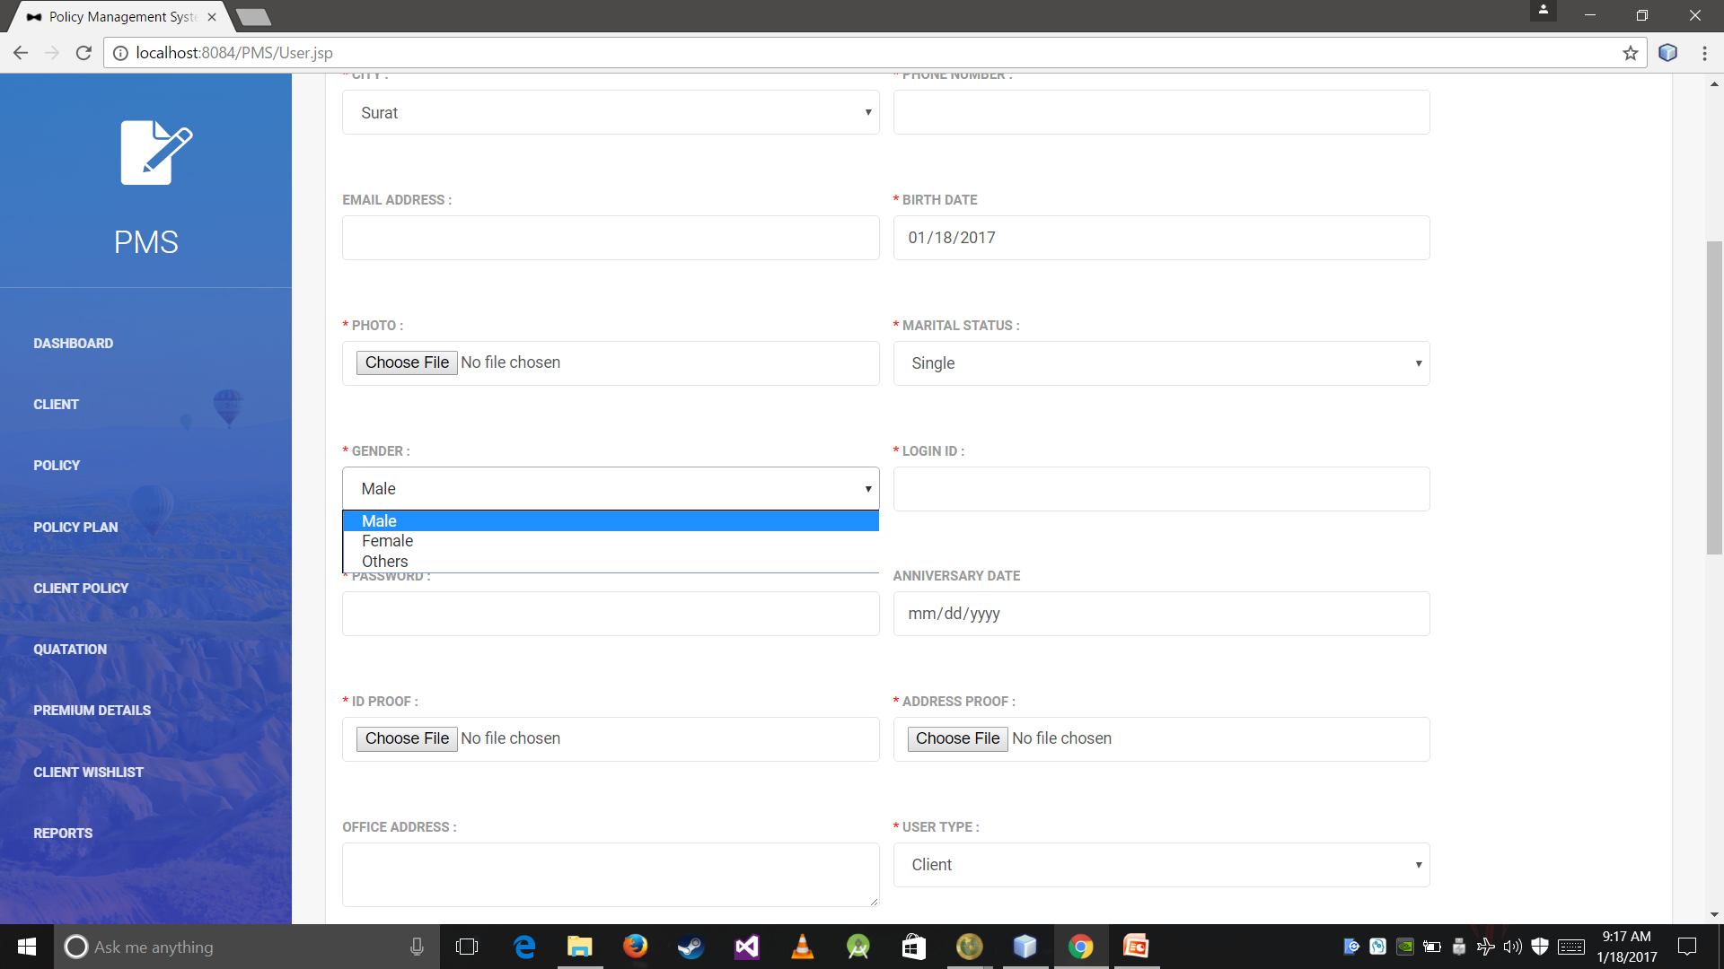

Slide 49
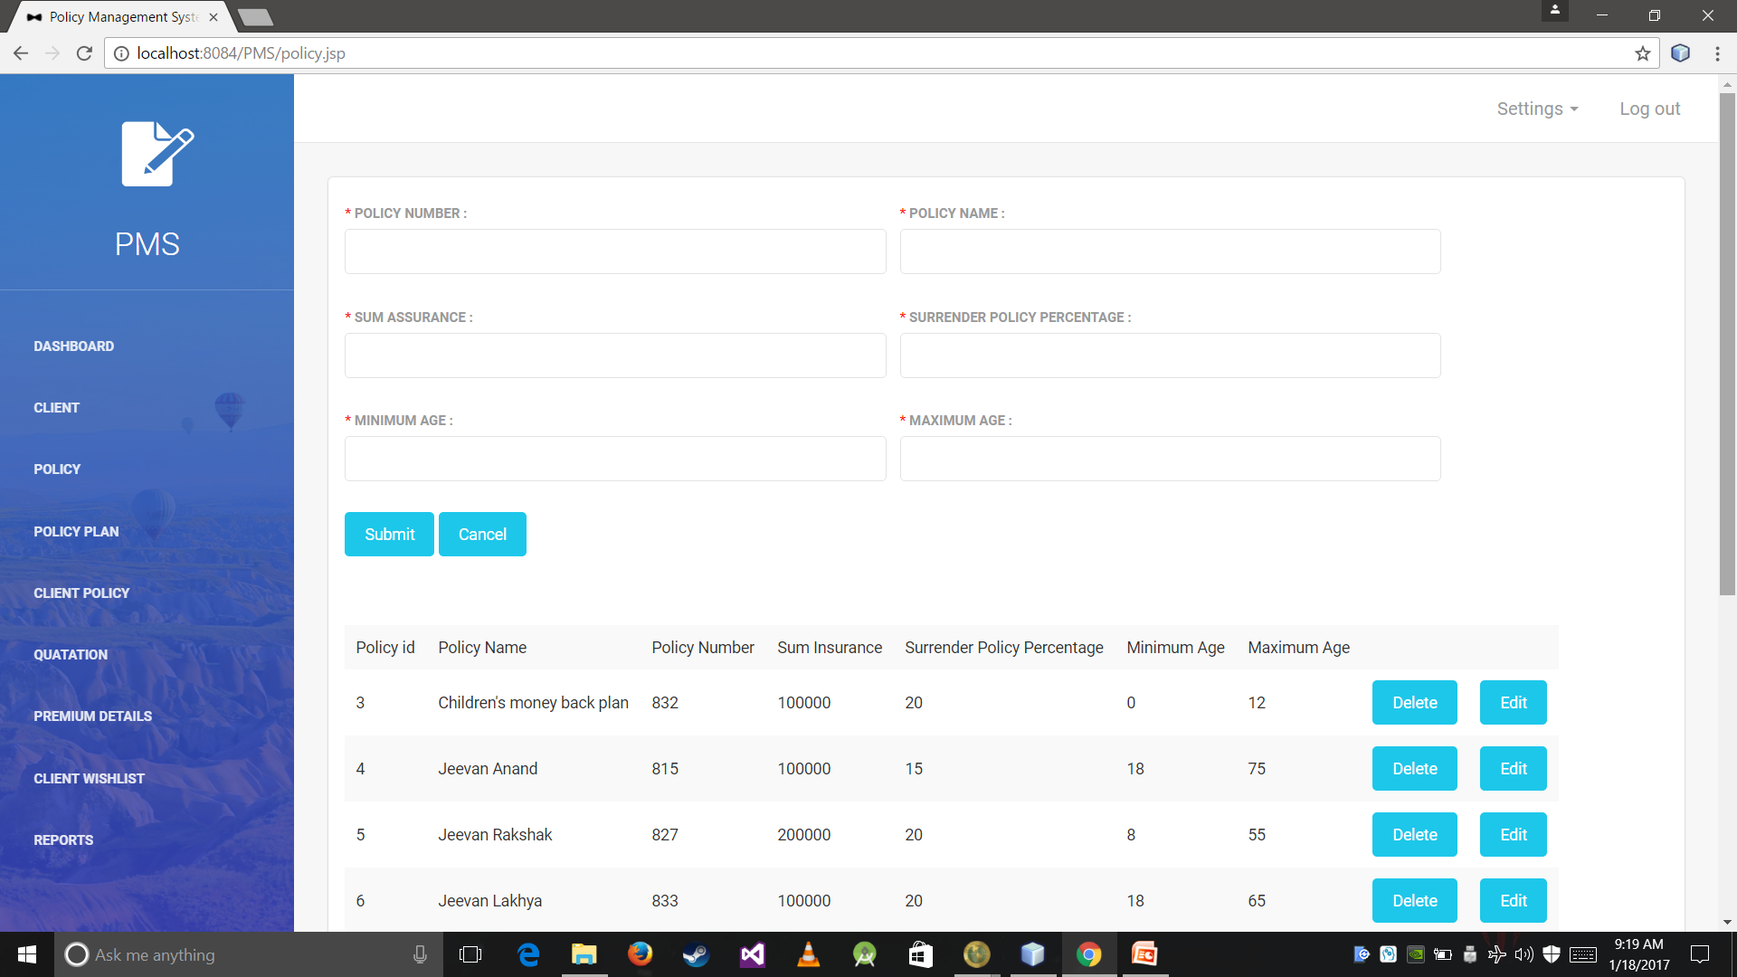

Slide 50
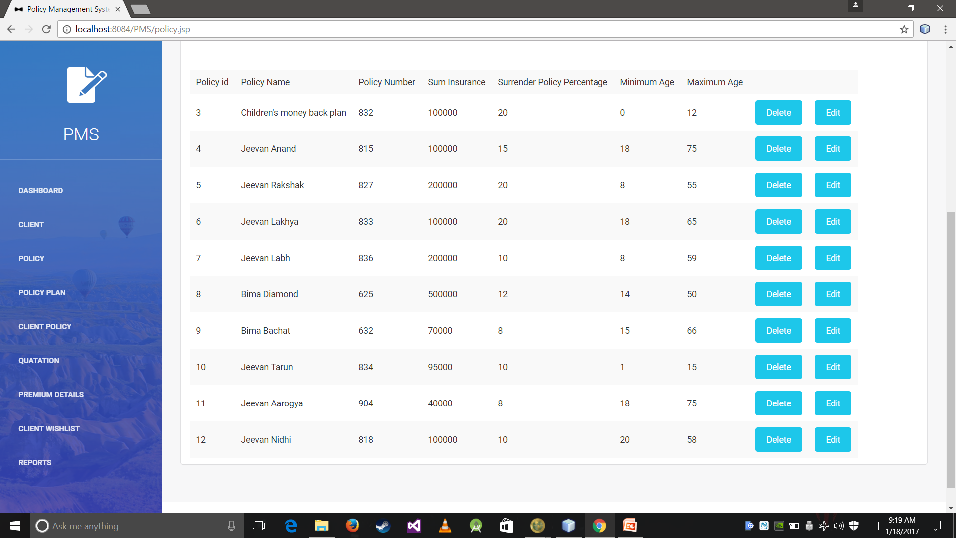

Slide 51
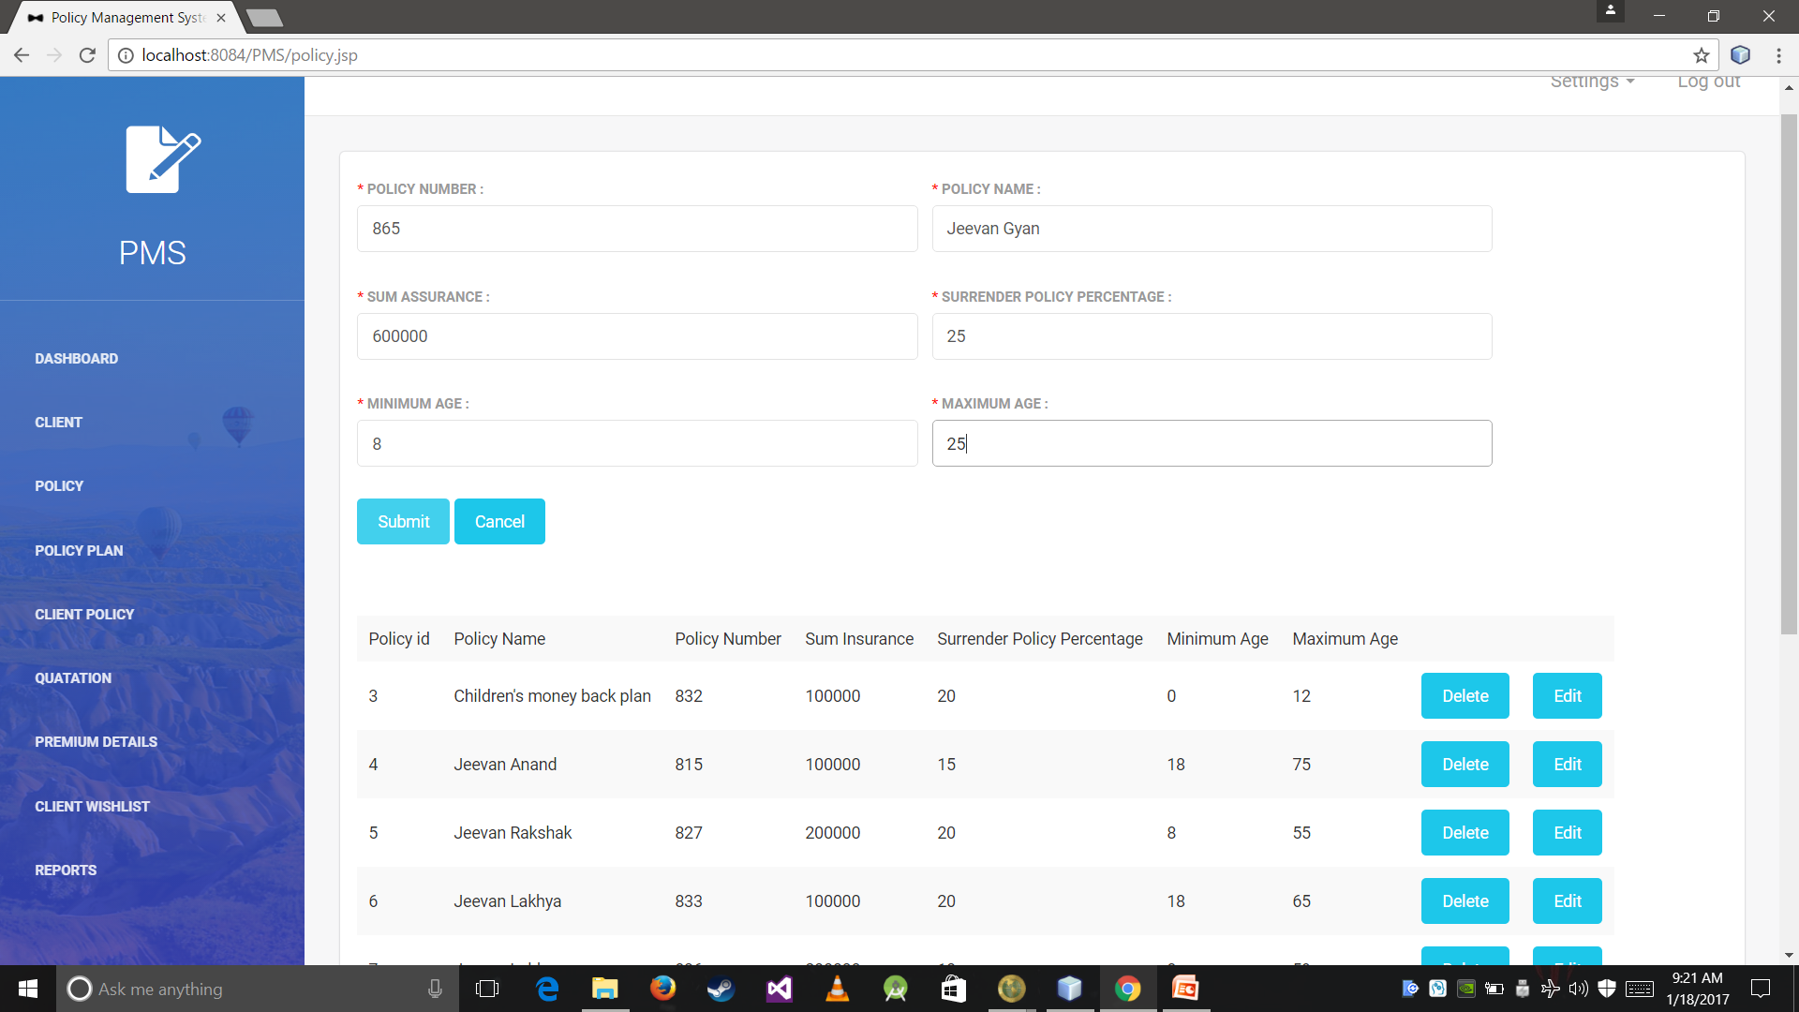

Slide 52
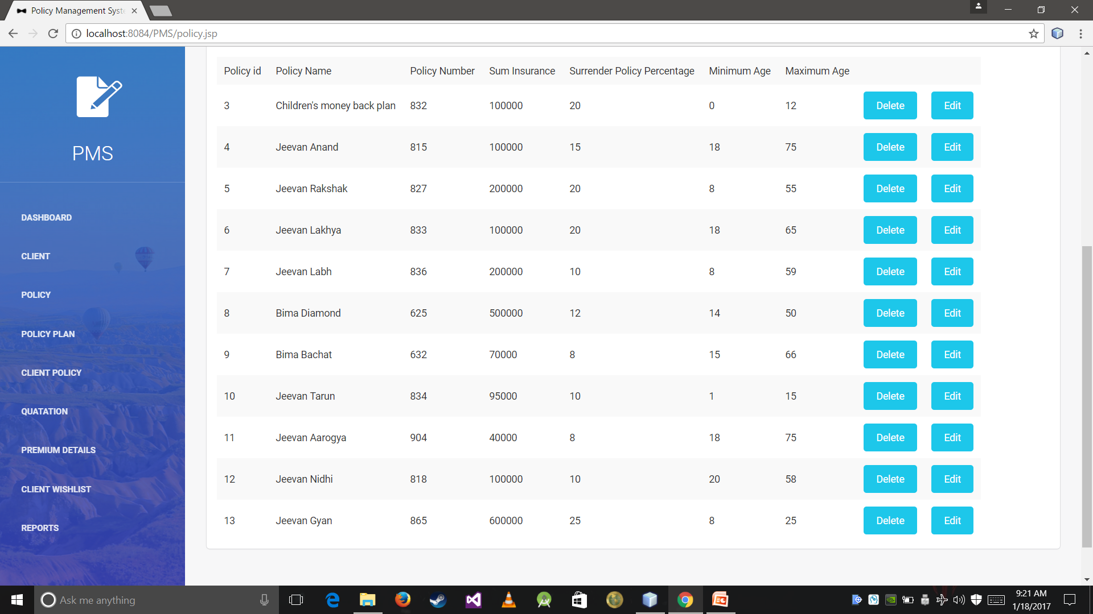

Slide 53
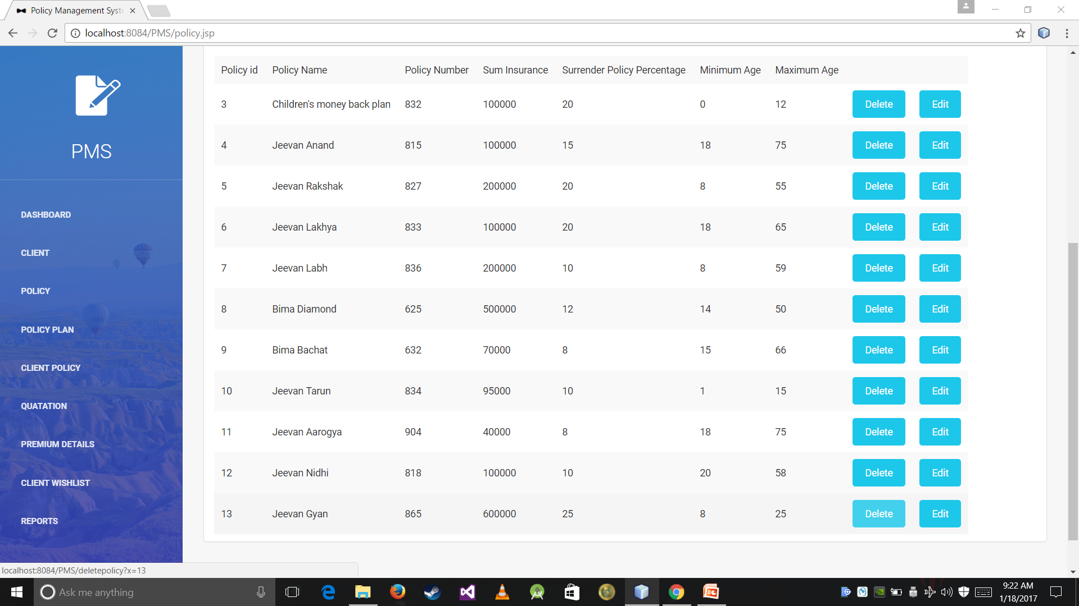

Slide 55
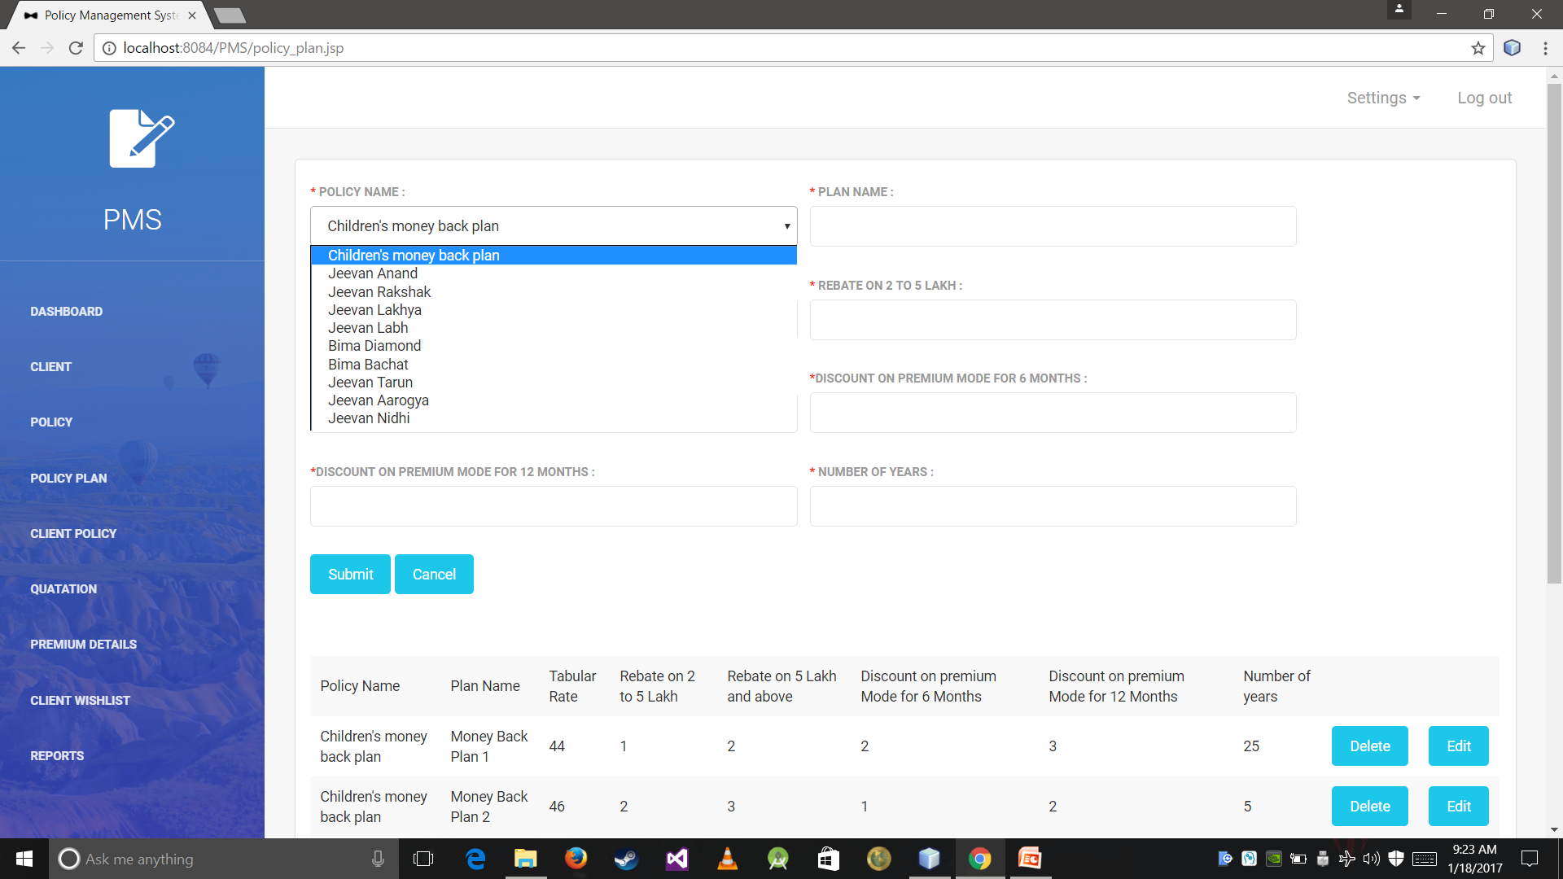

Slide 56
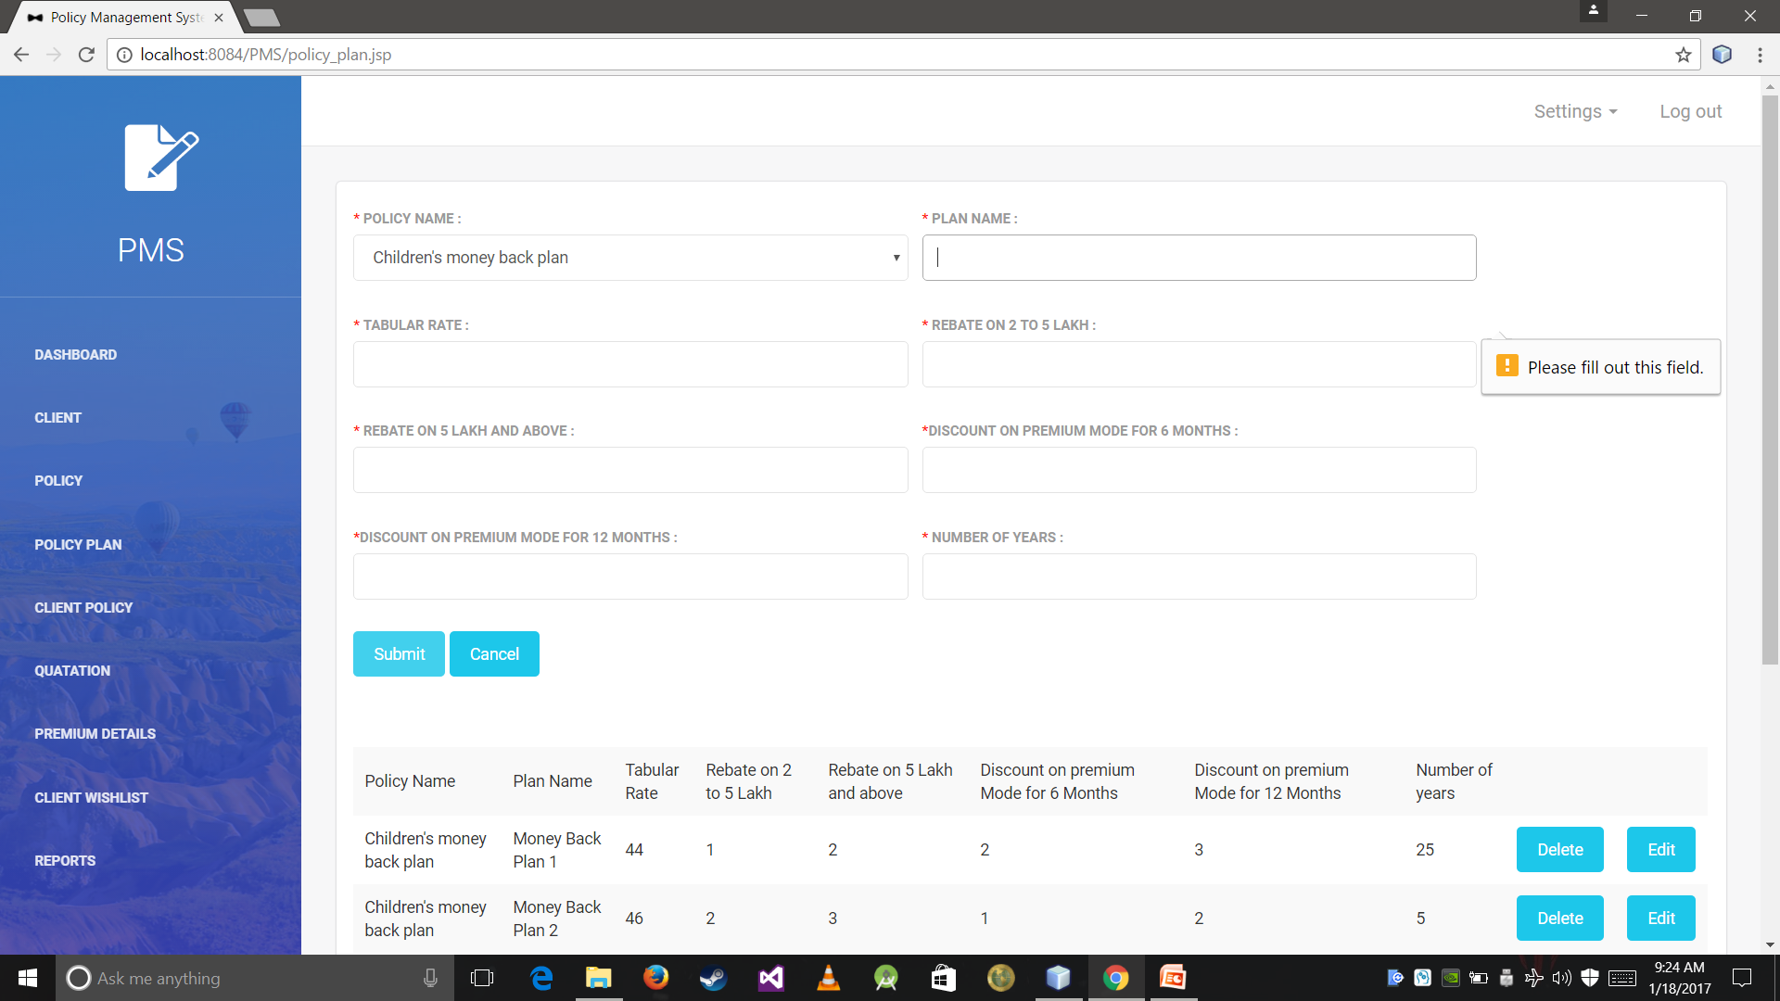

Slide 57
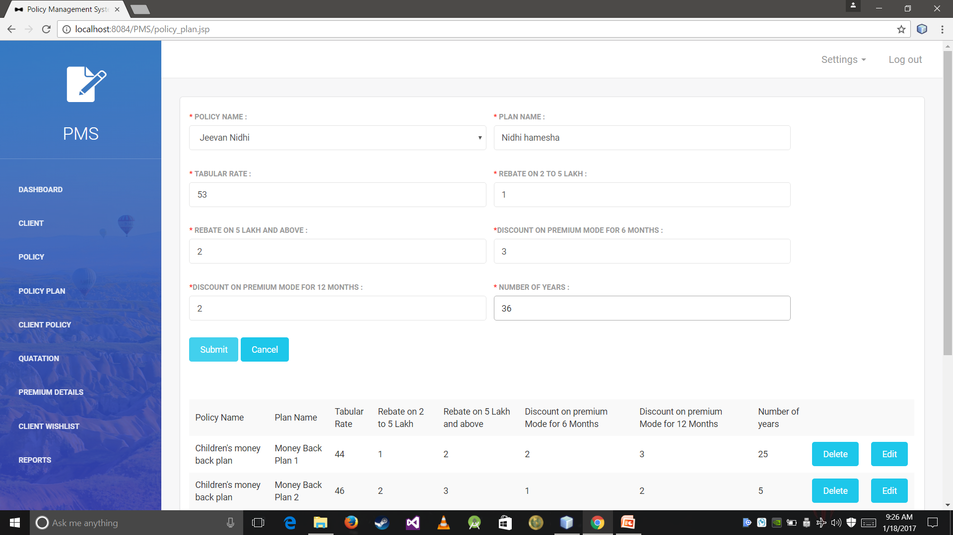

Slide 58
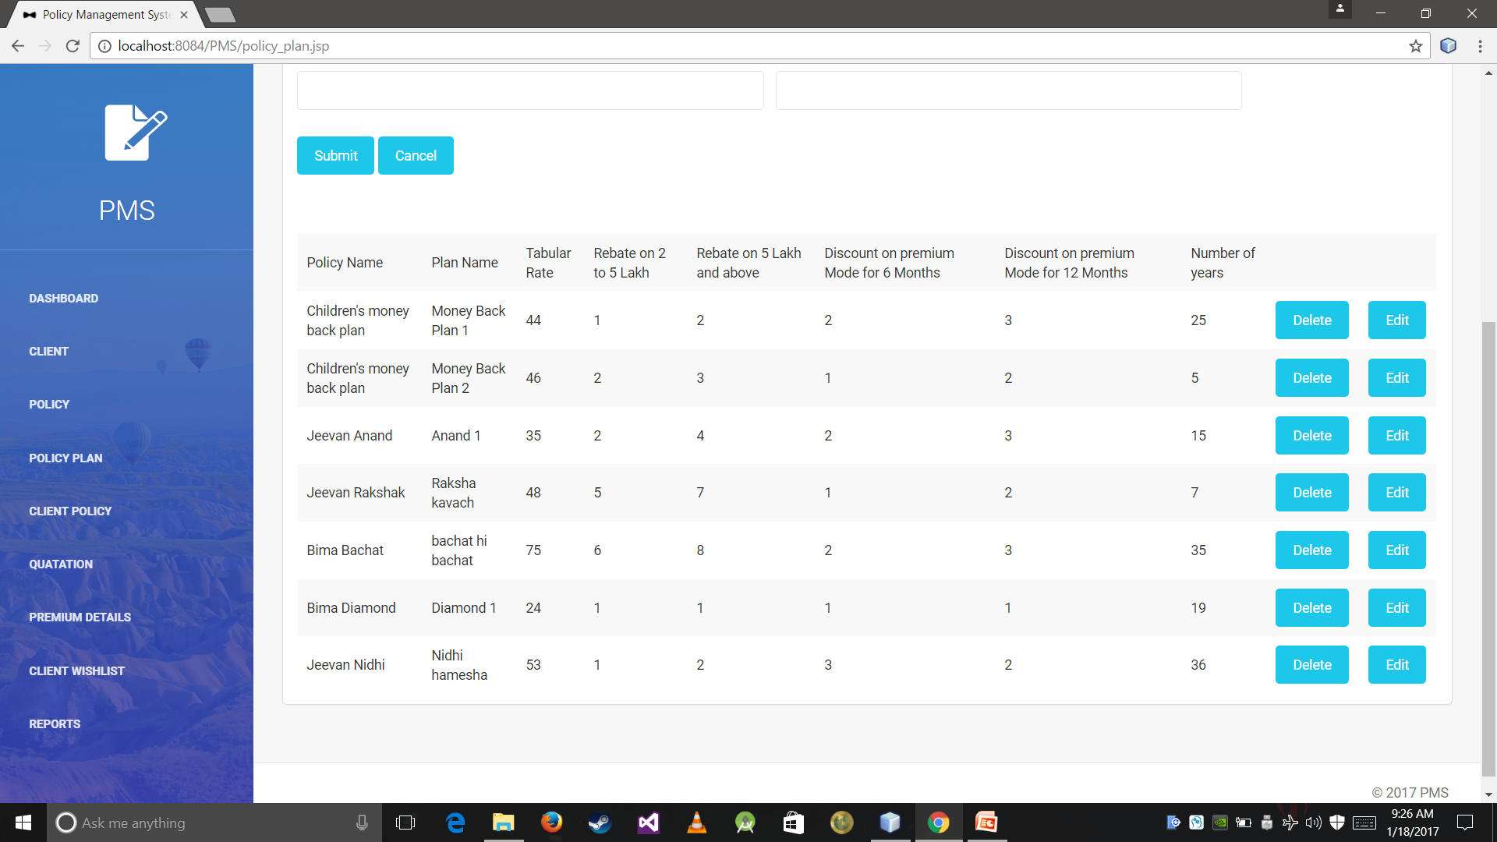

Slide 59
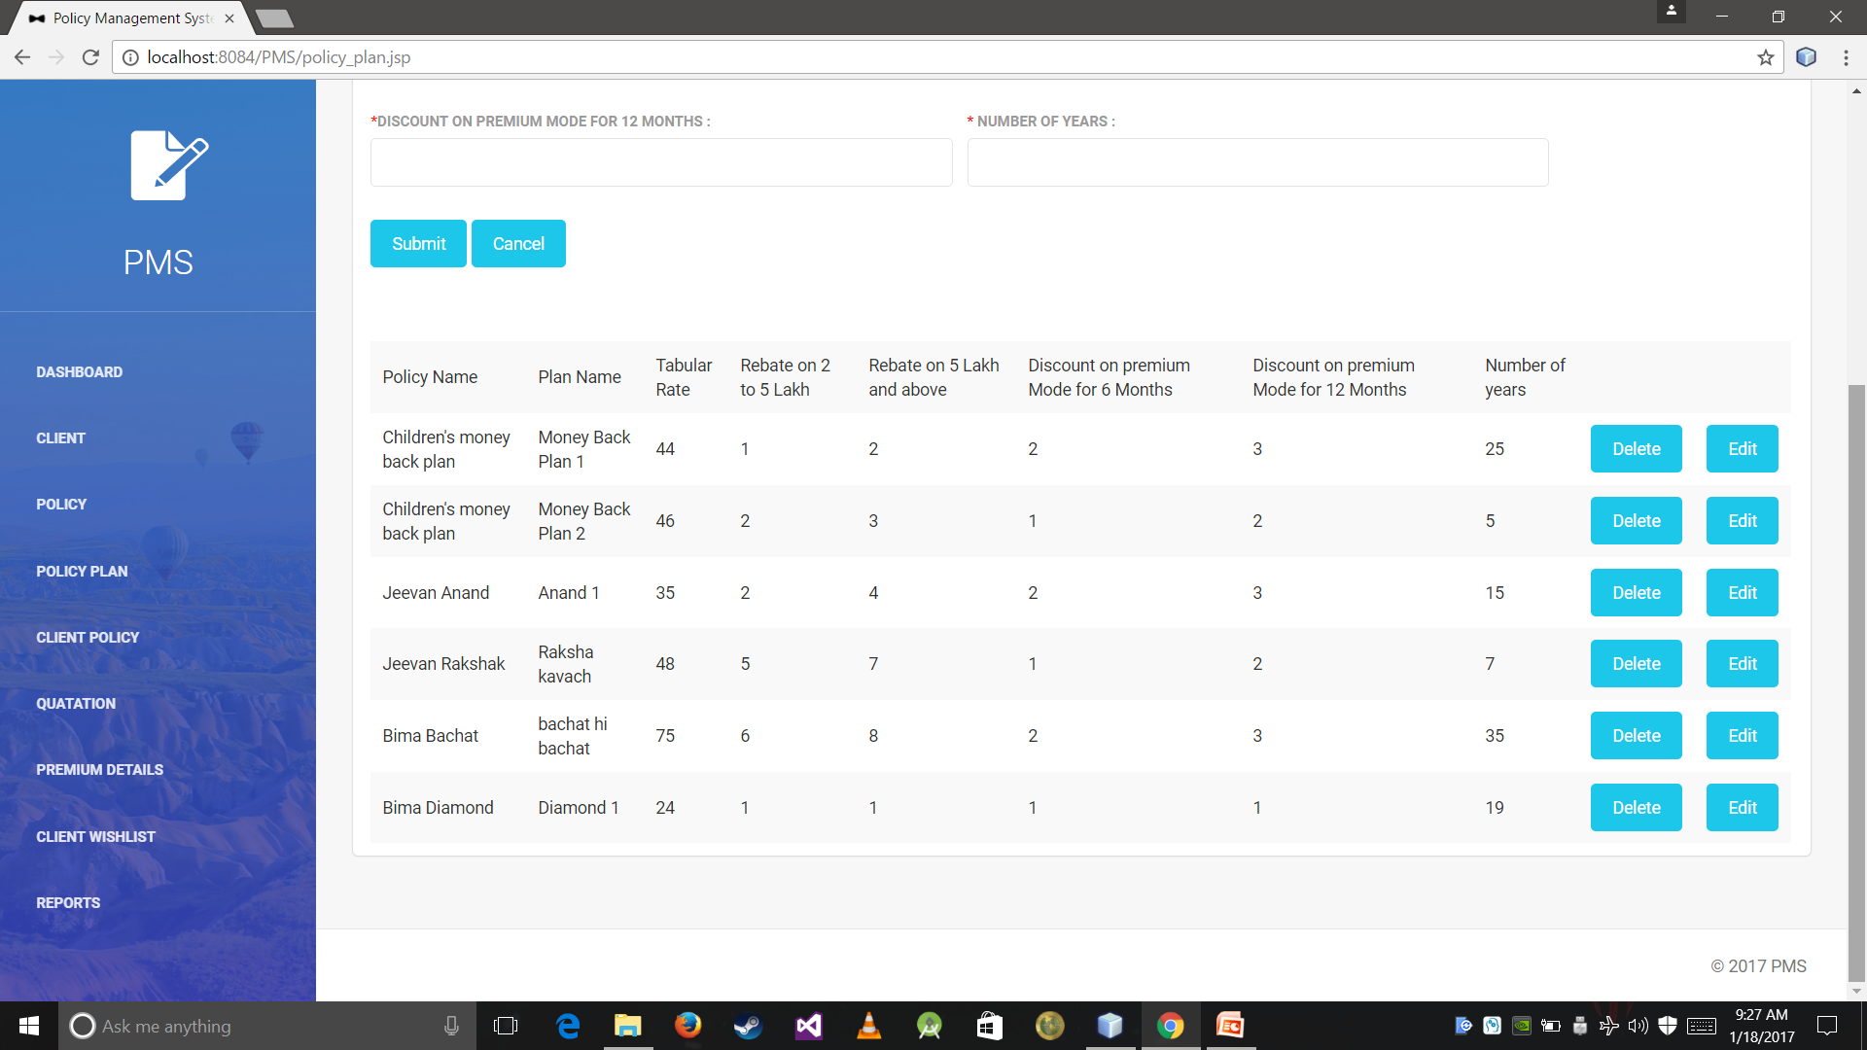

Slide 60


Slide 61
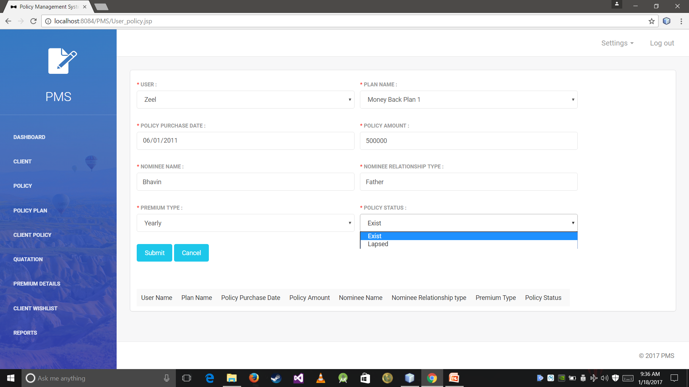

Slide 62


Slide 63
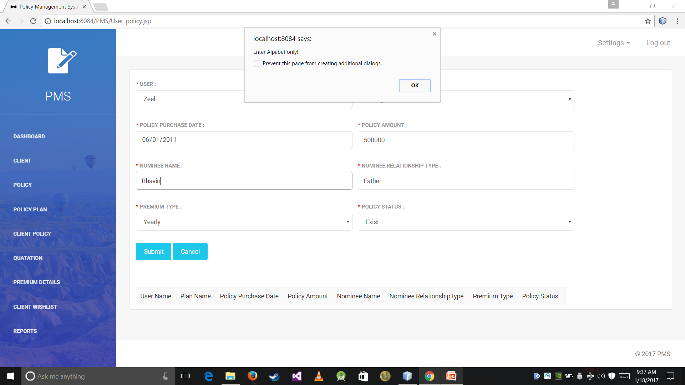

Slide 64
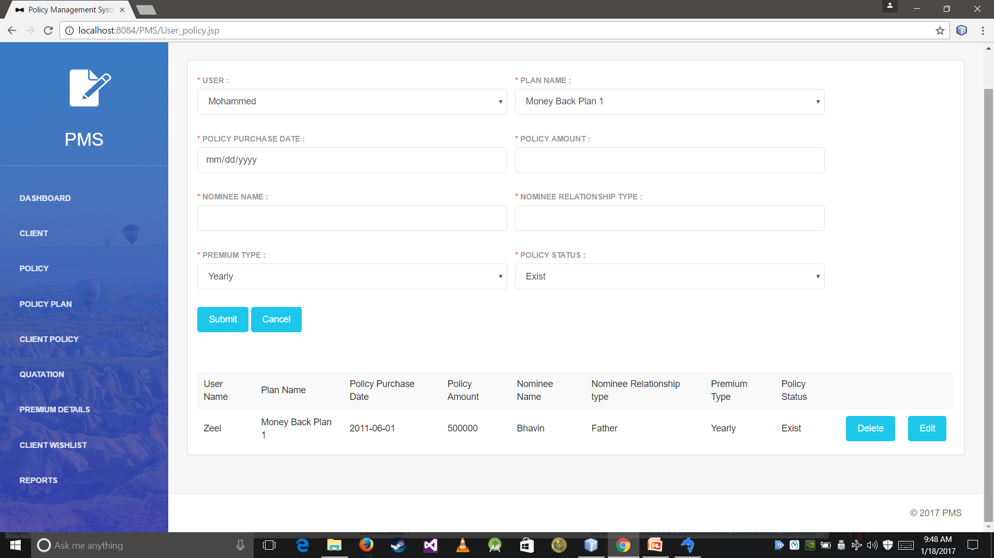

Slide 65
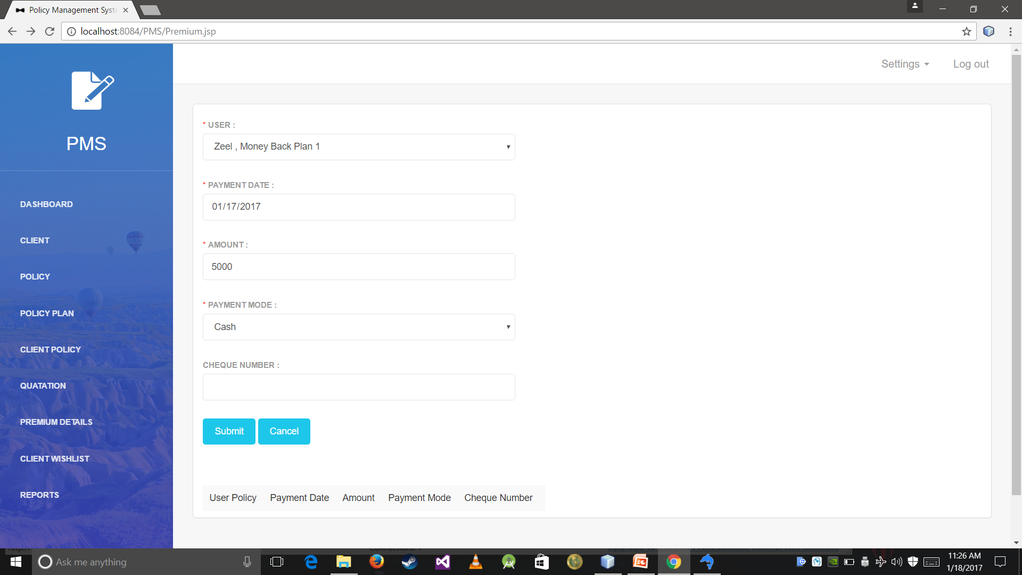

Slide 66
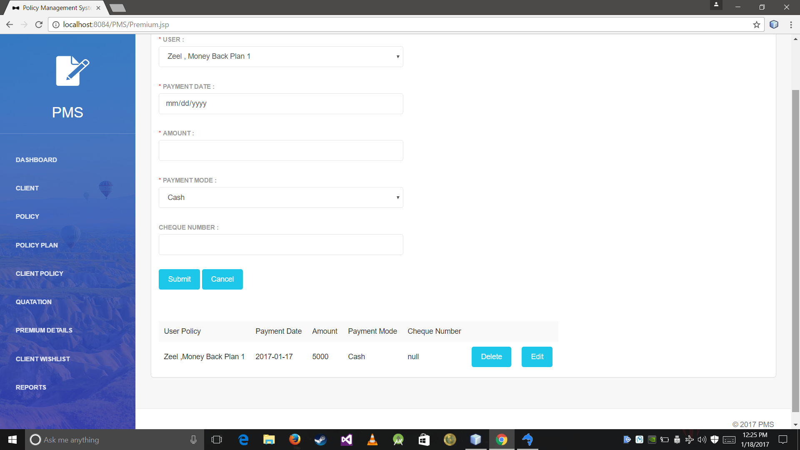

Slide 67
THANK YOU

